Slide 1
INDICAZIONI ALLA REVISIONE: DEFINIZIONE E CRITERI
Paolo bernante
Alma mater studiorum universita’ di bologna
Centro di chirurgia metabolica e dell’obesita’

Slide 2
DISCLOSURE
CONSULENTE DI UNIBO PER MEDTRONIC

Slide 3

Definition of success
  - Durable control of weight loss with resolution or improvement of comorbid conditions and good QoL
  - EWL > 50% (Adelaide study group, Reinhold)
Definition of failure
  - Inadequate weight loss or weight regain
  - No consensus
  - EWL < 40% (Fobi)
  - Should be based on the expected average results of a particular operation

Slide 4

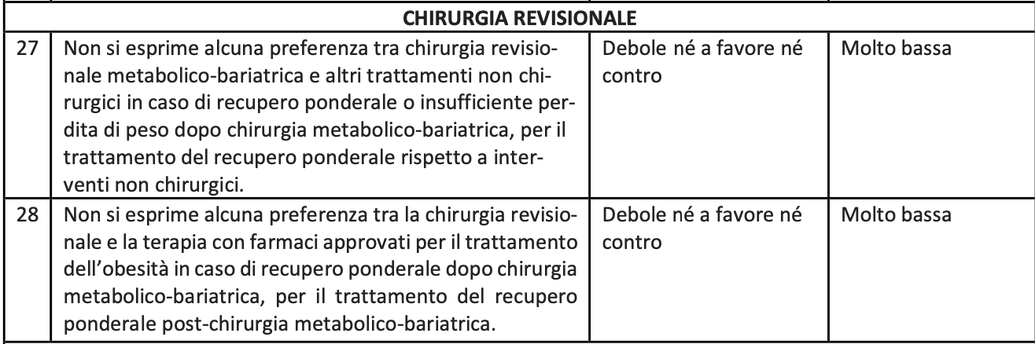

Slide 5

2023

Slide 6
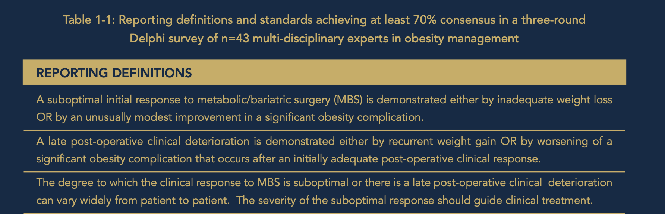

Slide 7
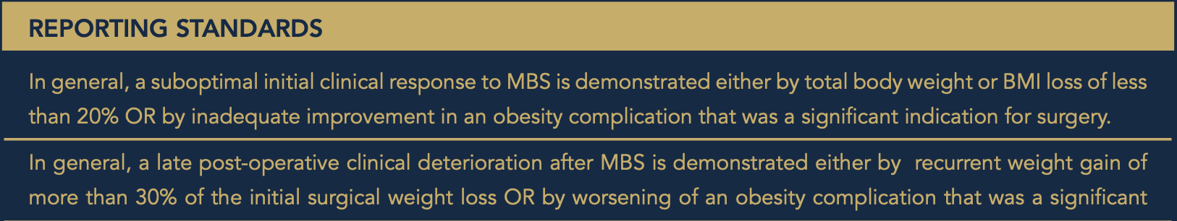

Slide 8
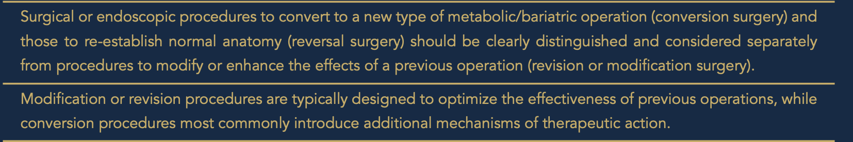
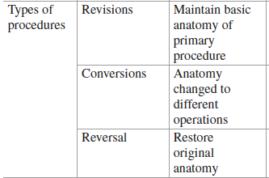

Slide 9
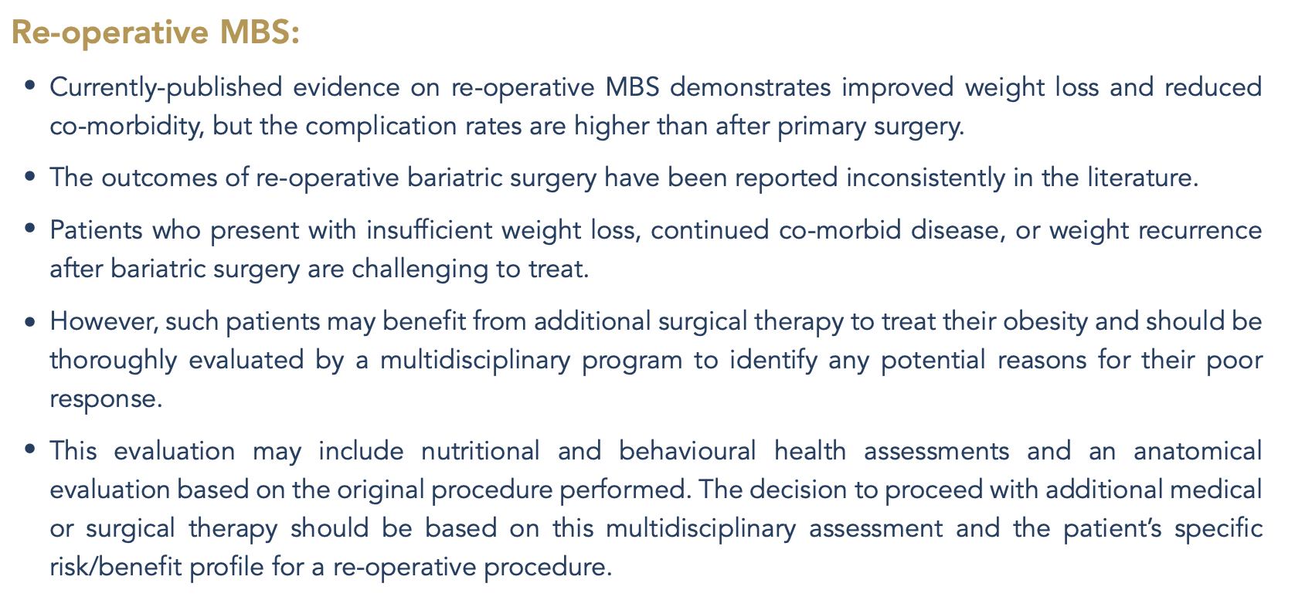

Slide 10
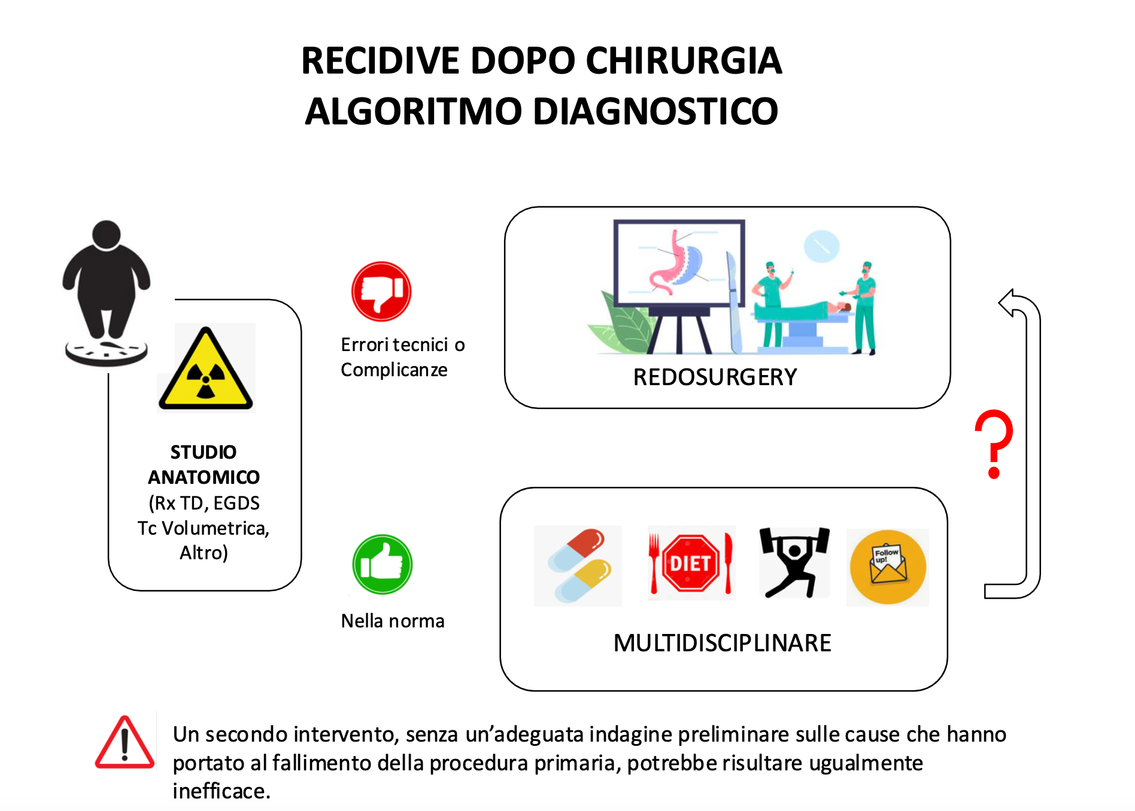

Slide 11
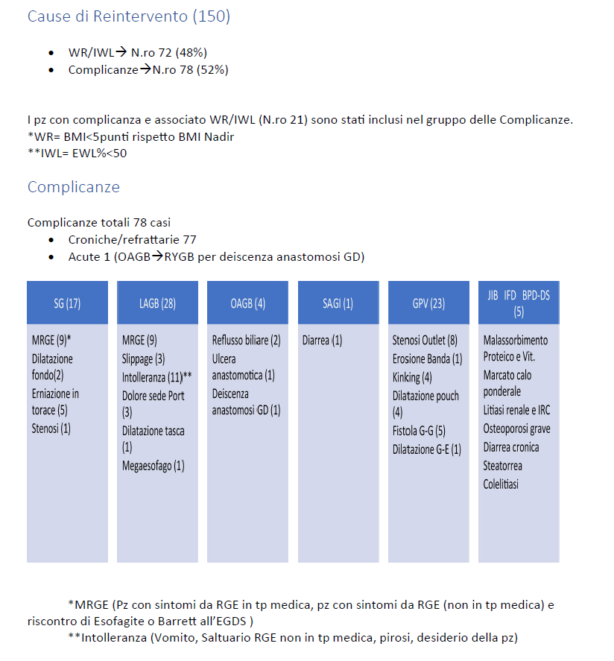
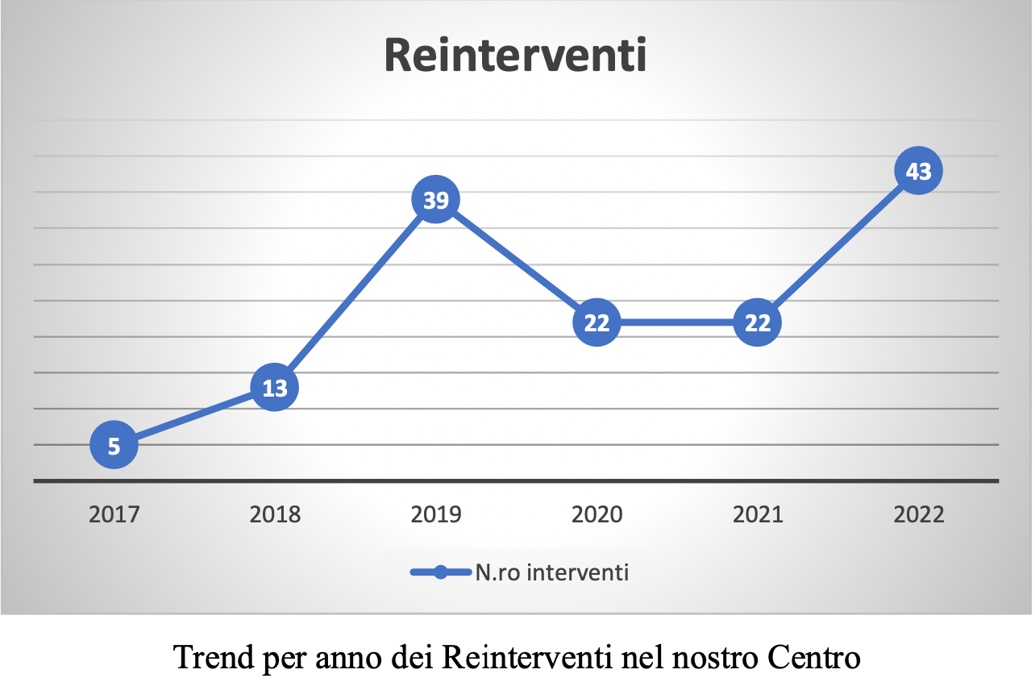

Slide 12
Grazie

